Slide 1
Introduction to Energy Systems
Module 7
Wind Power
Prepared by: Prof. Amin Ghobeity
Please do not distribute without permission

Slide 2


References
+ Instructor notes
Energy Systems Engineering: Evaluation and Implementation, 4th Ed.
McGraw-Hill, New York, 2020
Chapter 13 Solar Photovoltaic Technologies
Alternative Energy Systems and Applications
By Hodge

Slide 3
Learning Objectives
The different designs of wind turbines.
The physics of the energy content of wind.
Wind power potential and maximum theoretical wind to power conversion (Betz limit).
The efficiency of different wind turbine designs and the importance of the tip speed ratio.
Estimation of yearly electricity generation from a wind turbine.
Economics of wind power.
The design of wind farms.

Slide 4
INTRODUCTION
Windmill: It is used for mechanical power generation (grinding grain, pumping water, etc.).
Wind turbine: It is used for electrical power generation.
Technically both devices are turbines since they extract energy from the fluid.
Capacity: Commercial wind turbines generate from 100 kW to 3.2 MW of electric power each at peak design conditions. The largest one has over 8 MW capacity.
Rotor diameter: The blade span (or rotor) diameter of the 3.2 MW wind turbine built by Boeing Engineering is 320 ft (97.5 m).
Location: Wind turbines need to be located where the wind velocity makes wind power economical, which is often far from traditional power grids, requiring construction of new high-voltage power lines.

Slide 5
WIND TURBINE TYPES
Numerous innovative wind turbine designs have been proposed and tested over the centuries.
Categories: We generally categorize wind turbines by the orientation of their axis of rotation
  - horizontal axis wind turbines (HAWTs)
  - vertical axis wind turbines (VAWTs)
Alternative classification: An alternative way to categorize them is by the mechanism that provides torque to the rotating shaft: lift or drag
  The component of force acting along the streamline is called Drag and the component of force acting perpendicular to the streamline is called lift.
Which type is used? Lift-type HAWT
Other designs have not achieved the same success.
Wind farm: Clusters of wind turbines.

Slide 6
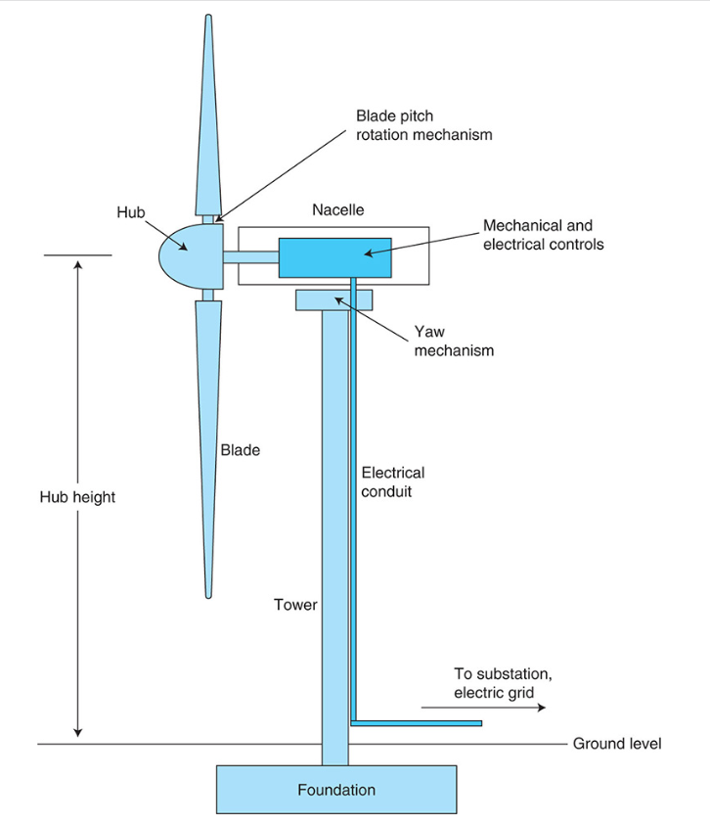
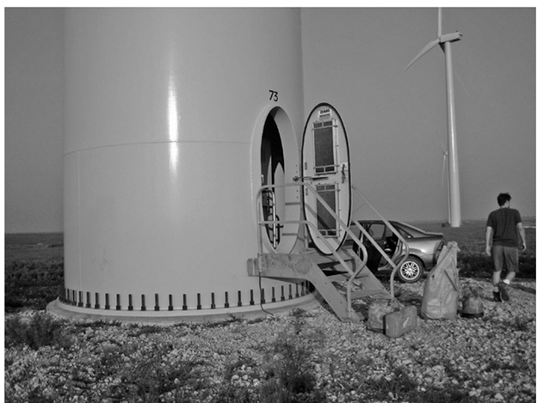
HAWT
The horizontal axis wind turbine (HAWT) system consists of blades attached to a central hub to form a rotor that rotates when force is exerted upon them by the wind.
The hub is in turn attached to a driveshaft that transmits rotational energy to the interior of the nacelle, a central enclosure that sits atop the turbine tower and is rotated by a “yaw mechanism” on a vertical axis to face the wind from any direction (here “yaw” is defined as the angular orientation of the nacelle and rotor around its vertical axis.)
The nacelle contains the bearing for the driveshaft, the transmission, generator, mechanical brake, and gears and drives to change both the orientation of the nacelle and the pitch of the turbine blades.
Wind turbine component video: https://energyeducation.ca/encyclopedia/Wind_turbine
Wind turbine construction video: https://www.youtube.com/watch?v=84BeVq2Jm88

Slide 7
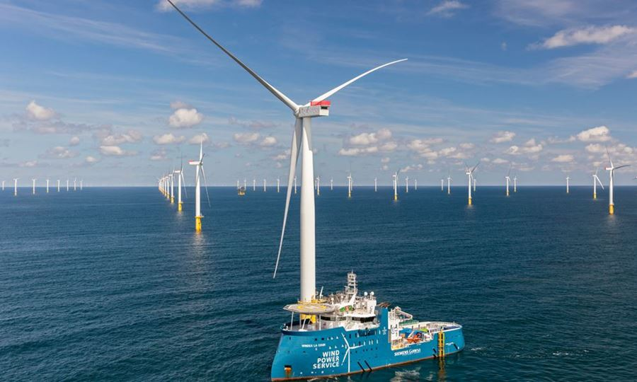
Onshore and Offshore Wind
Onshore wind comprises any wind installation that is installed on land, as opposed to offshore wind, which is installed in bodies of water adjacent to land
Offshore wind installations currently require shallow depths, on the order of 30 m (100 ft) or less, so that the tower can be sunk directly into the sea floor below the surface.
In offshore installation larger components are used (unlike onshore sites, where road widths and other factors limit the maximum size of components)
Maximum size offshore turbines have therefore reached 5 and 6 MW, and may eventually grow to 10 MW
“Floating” turbine designs the tower rests on a submerged but buoyant platform that is in turn tethered to the sea floor using an anchoring system (albeit at a cost premium beyond the non-floating offshore technology).
https://www.siemensgamesa.com/explore/journal/2021/03/siemens-gamesa-windeurope-offshore-onshore

Slide 8
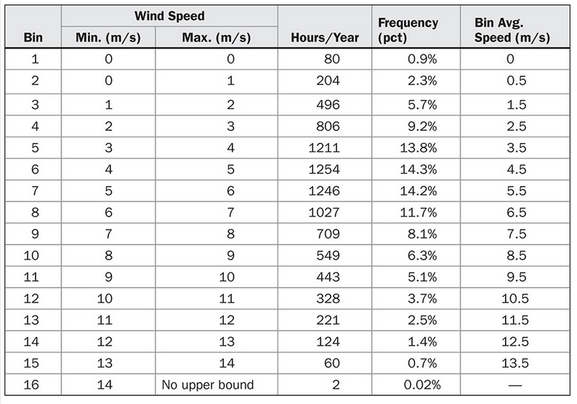

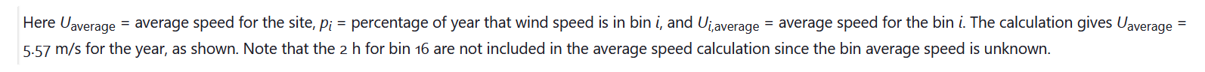
Wind Resource and Wind Resource Models

Slide 9
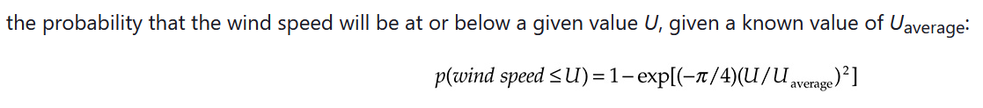
Statistical Distributions to Approximate Available Energy
The distribution of wind speeds in bins provides a solid basis for calculating available energy at this site. However, suppose we only knew U_{average} = 5.57 m/s, and did not have the hourly bin data for the year. Observations have shown that in many locations, if the average wind speed is known, the probability of the wind speed being in a given range can be predicted using the Weibull distributions
A special case of Weibull distribution with k=2 is called Rayleigh distribution and used to find the probability of wind speed below a certain wind speed of u

Slide 10
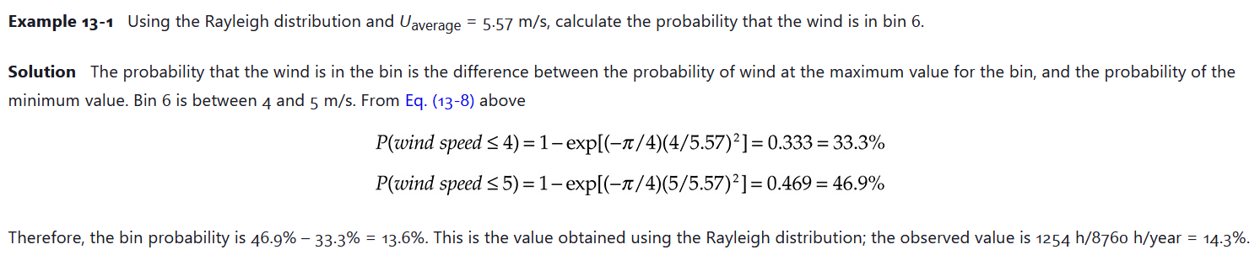
Example

Slide 11
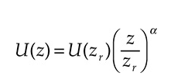
Wind Speed vs. Height
The effect of height above the ground can be approximated by the following equation:
z is the height above the ground, z_{r} is some reference height above the ground for which wind speed is known, U(z) is the wind speed as a function of height
α is the wind shear coefficient. A typical value of the wind shear in flat locations might be α = 0.2.

Slide 12

Wind Power Potential
Mechanical energy: The form of energy that can be converted to mechanical work completely and directly by an ideal mechanical device such as an ideal turbine.
P/ρ flow energy,
V²/2 kinetic energy
gz potential energy
ṁ mass flow rate of the fluid
The pressures at the inlet and exit of a wind turbine are both equal to the atmospheric pressure and the elevation does not change across a wind turbine.
Flow energy and potential energy do not change across a wind turbine.
A wind turbine converts the kinetic energy of the fluid into power.

Slide 13

Wind Power Potential
The available power relation indicates that the power potential of a wind turbine is proportional to density of air. As a result, cold air has a higher wind power potential than the warm air.
P = ρRT
Ideal gas relation
Gas constant, R = 0.287 kPa⋅m³/kg⋅K
R=0.3704 psia.ft³/lb_{m}.R
A = πD²/4 Disk area D: blade diameter

Slide 14
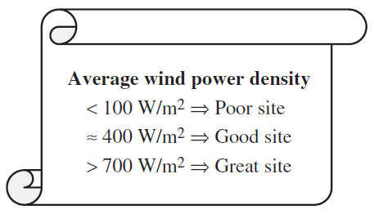
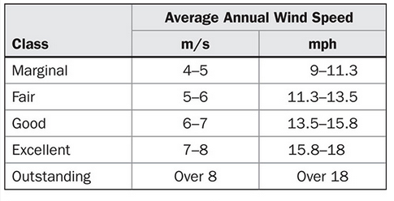
Wind Power Density
Wind power density is available wind power per unit area and is used to evaluate various locations for wind turbine potentials

Slide 15
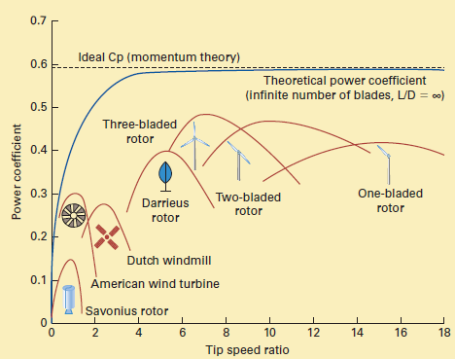


Wind Turbine Efficiency – Power Coefficient
Turbine performance is a function of tip speed ratio
The ratio of the translational velocity of the tip of the turbine blade to the wind speed is called the tip speed ratio (TSR), and is calculated as follows:
Ω, is angular velocity measured in rad/s,
$P_{wt}=C_{p}$ $P_{w}={0.5C}_{p}ρAu^{3}$

Slide 16
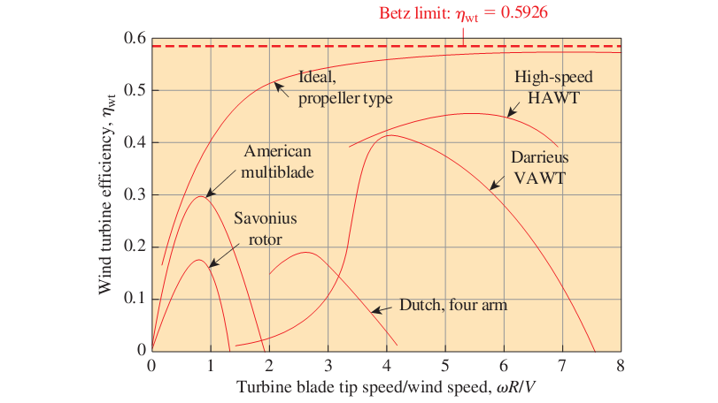
Theoretical Limits on Turbine Performance – Bentz Limit
It can be shown that power coefficient can have a maximum theoretical value.
This limit is known as Betz limit and is 0.5926

Slide 17
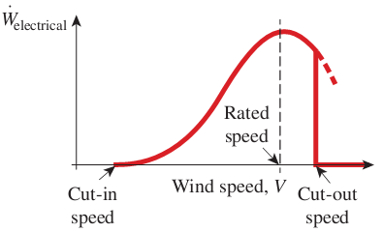
Characteristic Power Curve
Every wind turbine has a characteristic power performance curve.
Cut-in speed is the minimum wind speed at which useful power can be generated.
Rated speed is the wind speed that delivers the rated power, usually the maximum power.
Cut-out speed is the maximum wind speed at which the wind turbine is designed to produce power. At wind speeds greater than the cut-out speed, the turbine blades are stopped by some type of braking mechanism to avoid damage and for safety issues. The short section of dashed blue line indicates the power that would be produced if cut-out were not implemented.

Slide 18
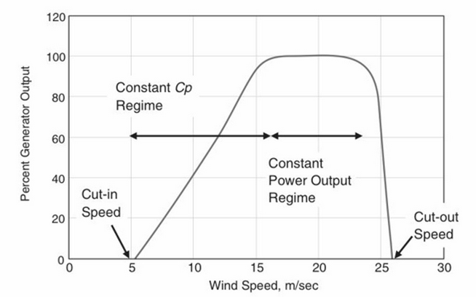
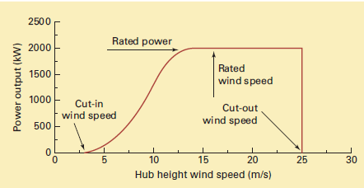
Wind Turbine Control
The design of HAWT turbine blades includes tapering and twist to control the turbine and maximize performance.

Slide 19
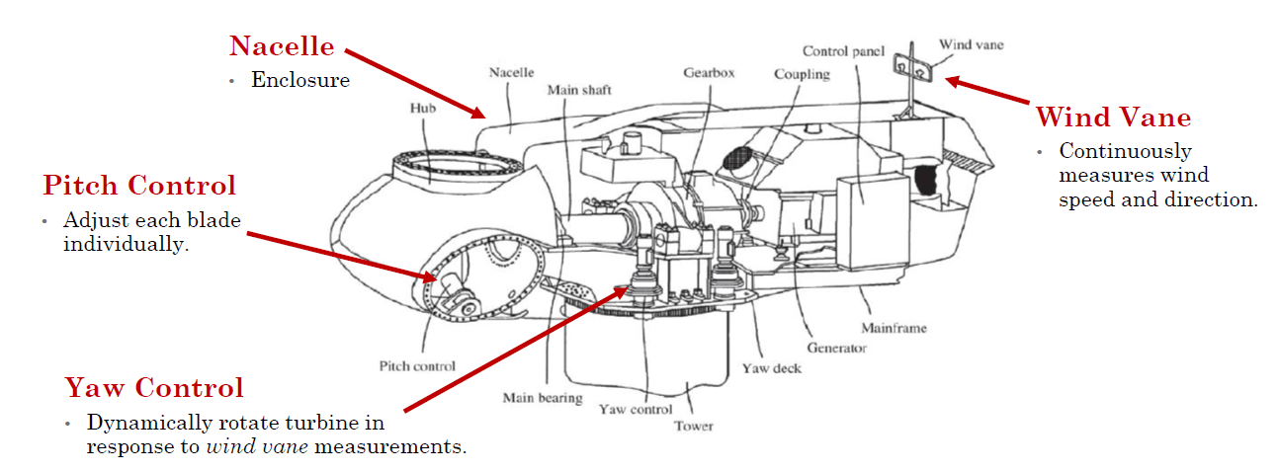
Wind Turbine Control
Wind power is controlled through primarily pitch control and yaw control
Tong, Wei. 2010. “Fundamentals of Wind Energy.” In Wind Power Generation and Wind Turbine Design, 3–48. Southampton: WIT Press.

Slide 20
Operating Strategies
  Maximum efficiency range: As wind speed increases from the cut-in speed, ideal turbine operation seeks to keep TSR in an ideal range to maximize output. For a utility-size turbine, TSR values between λ = 6 and λ = 8 are typical. Note that due to continuous slight variations in exact wind speed and direction, it is not possible to maintain a precise value for TSR; however, as long as the value is kept within a narrow range, the effect on conversion efficiency is acceptable.
  Maximum output range: As wind speed continues to increase, at some point before the device reaches the rated wind speed, the goal for ideal turbine operation shifts from maximizing efficiency to maintaining the rated output of the device without excessive physical stress on the various components, at the expense of lowering TSR. Thus wind speed continues to increase but the tip speed (product of swept area radius and angular velocity) increases only modestly compared to the highest values achieved in the maximum efficiency range.

Slide 21

Rated Capacity and Capacity Factor
Rated capacity or nameplate capacity is the power that turbine produces at rated speed (i.e., maximum power)
The actual output from wind installations is substantially lower than what would be generated at the rated wind speed continually
The capacity factor for a wind turbine is the actual annual output divided by the annual output that would be obtained if the devices functioned at rated capacity for the entire year. For a 1.5 MW turbine that produces13.1 GWh in a year the capacity factor is 44.4%

Slide 22
Environmental Consideration
Noise: this is a local concern for residents living within a kilometer or so of the wind turbine.
Effect on wildlife (i.e., risk to birds, bats, etc.): studies have shown that other anthropogenic factors (power lines, vehicles, etc.) are a much greater concern.
Land use: wind power is more compatible with dual land use than many other forms of energy. In many cases wind power and agriculture or solar energy can utilize common land.
Aesthetics: a concern associated with virtually all energy production methods
Accidents: Accidents can result from turbine failure e.g., generator fires, tower collapse or blade breakage (or a combination of these). These are a concern for nearby residents and roadways.

